Slide 1

IOC’s perspectives on CD and TMT, SDG14 and an Ocean Science Decade
Ariel Hernan Troisi
(IOC-UNESCO Vice-Chair)
SIDS Capacity Development Aspects in the BBNJ process
7 – 9 March 2017, Oostende/Brussels, Belgium

Slide 2
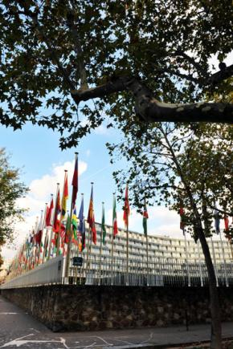


The IOC of UNESCO: Building knowledge and capacity for sustainable ocean management

Slide 3
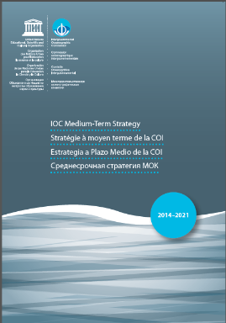
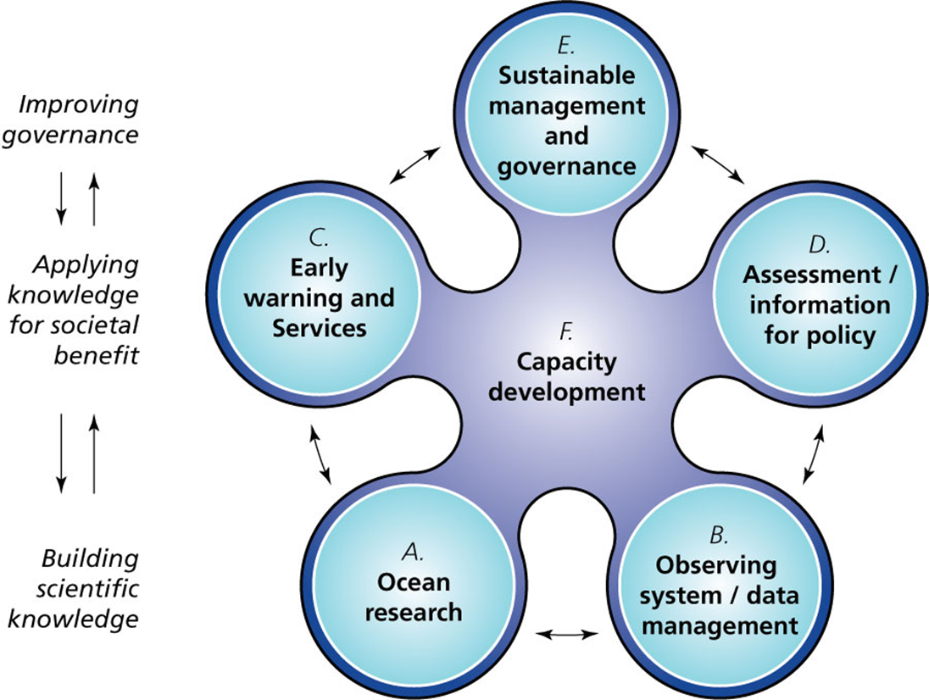
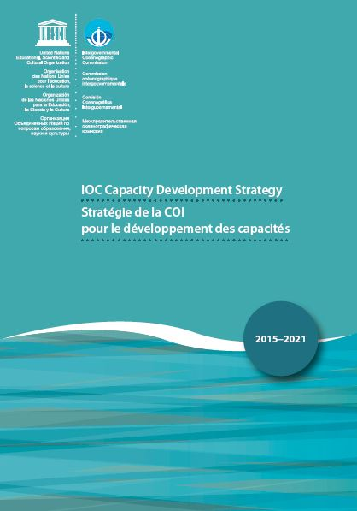
Access to infrastructure
Global, regional and sub-regional mechanisms
Ocean research policies
Visibility and awareness
Human resources
Resources mobilization

Slide 4
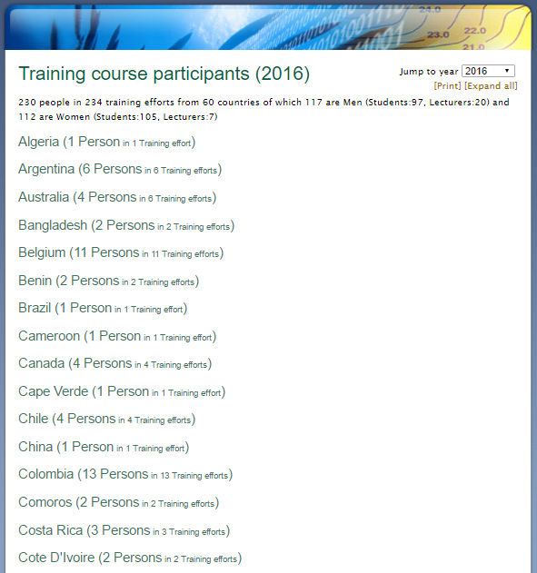
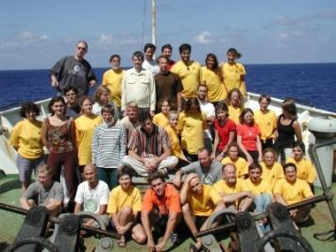
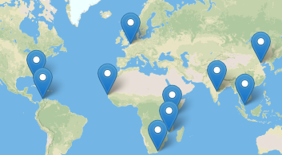
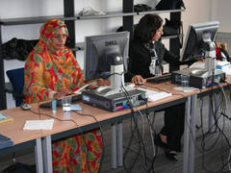
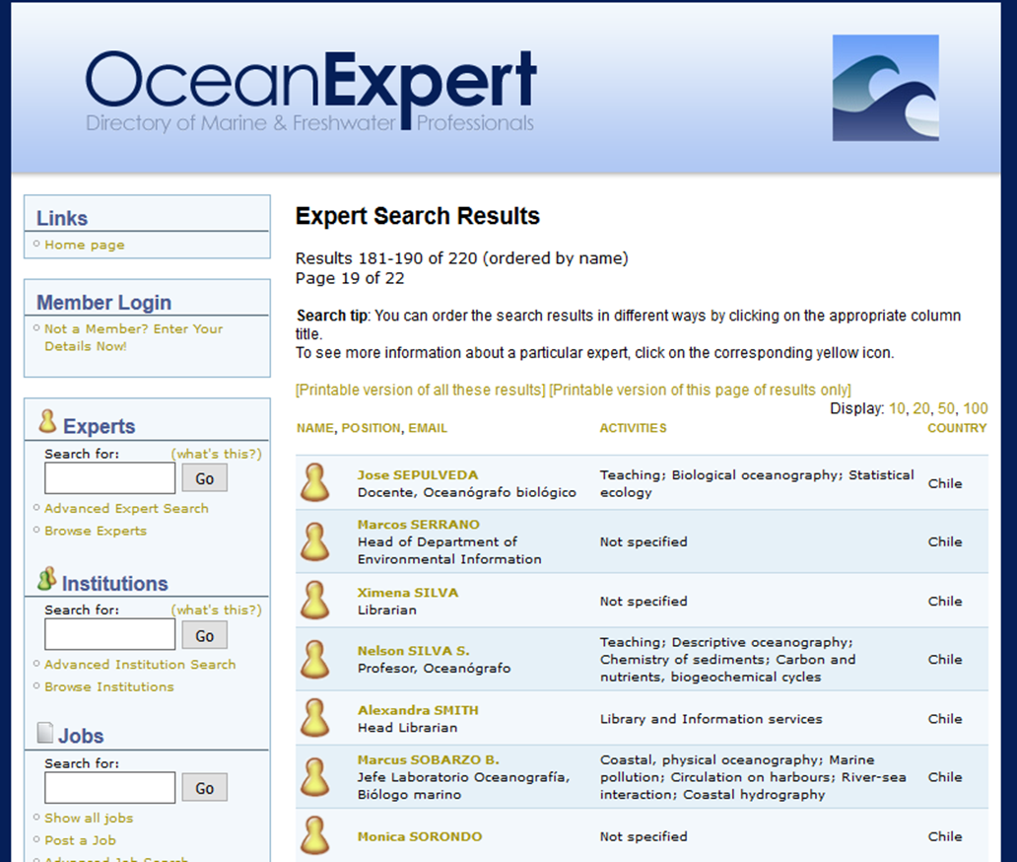
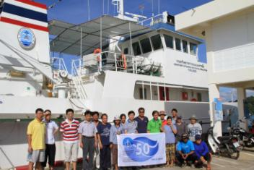
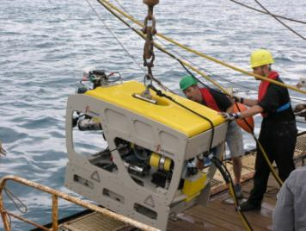
OceanTeacher Global Academy
http://www.oceanexpert.net/
Photos courtesy of: UNESCO PHOTO BANK

Slide 5
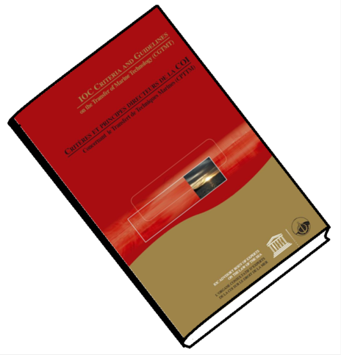


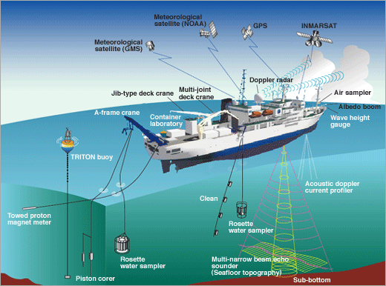
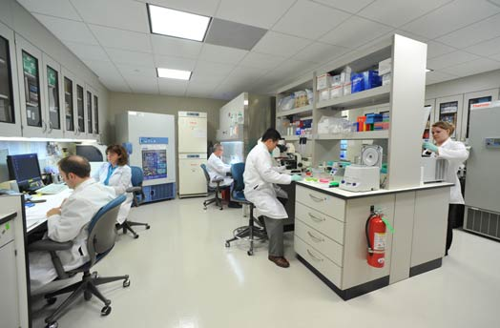
MARINE TECHNOLOGY

Slide 6

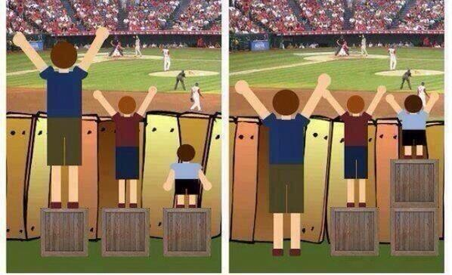



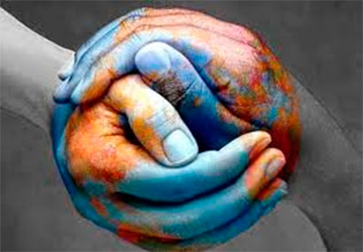
TRANSFER OF MARINE TECHNOLOGY CRITERIA

Slide 7
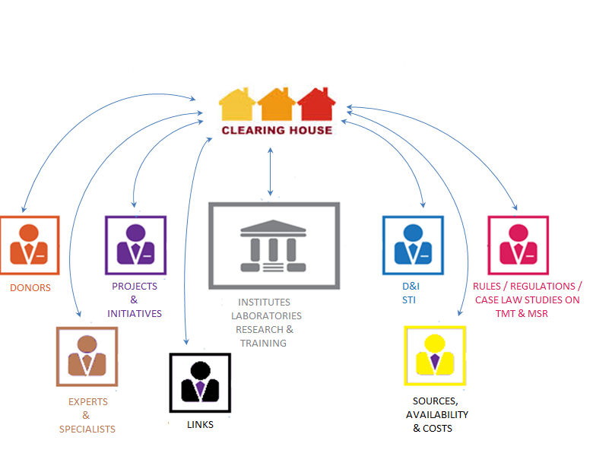


TRANSFER OF MARINE TECHNOLOGY MECHANISMS

Slide 8





TRANSFER OF MARINE TECHNOLOGY MECHANISMS (cont.)
STRATEGIC PLANNING
FOCAL POINTS

Slide 9
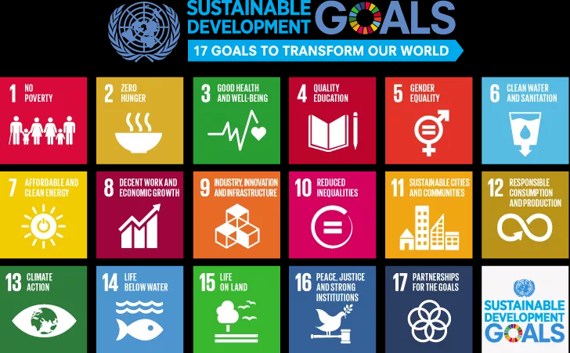
Conserve and sustainably use the oceans, seas and marine resources for sustainable development

Slide 10
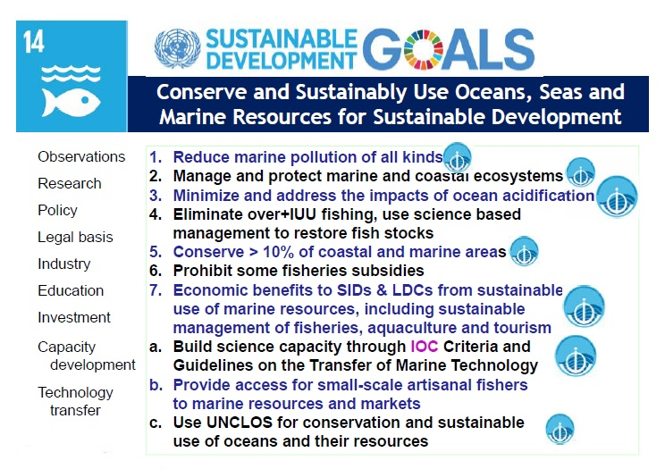

Slide 11



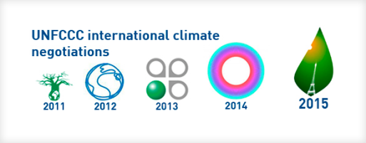

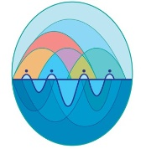
2016

Slide 12
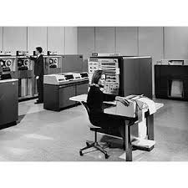
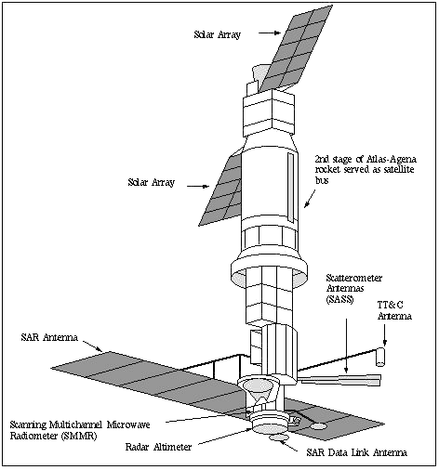
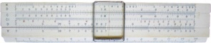
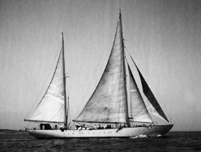

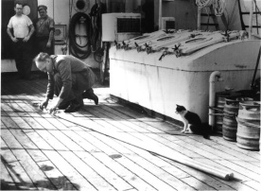
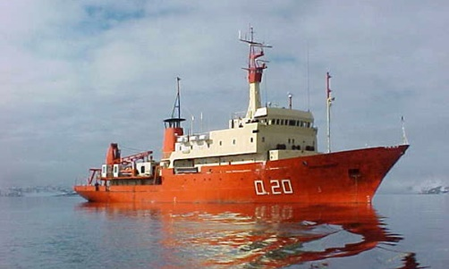
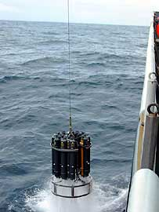
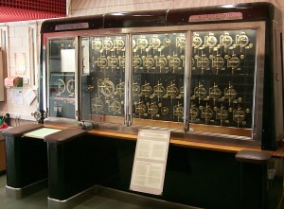
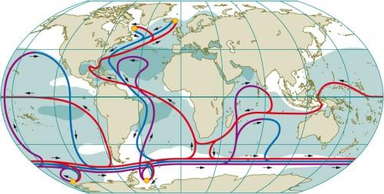
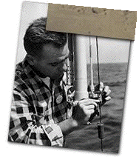
International Decade of Ocean Exploration (1971-1980)

Slide 13
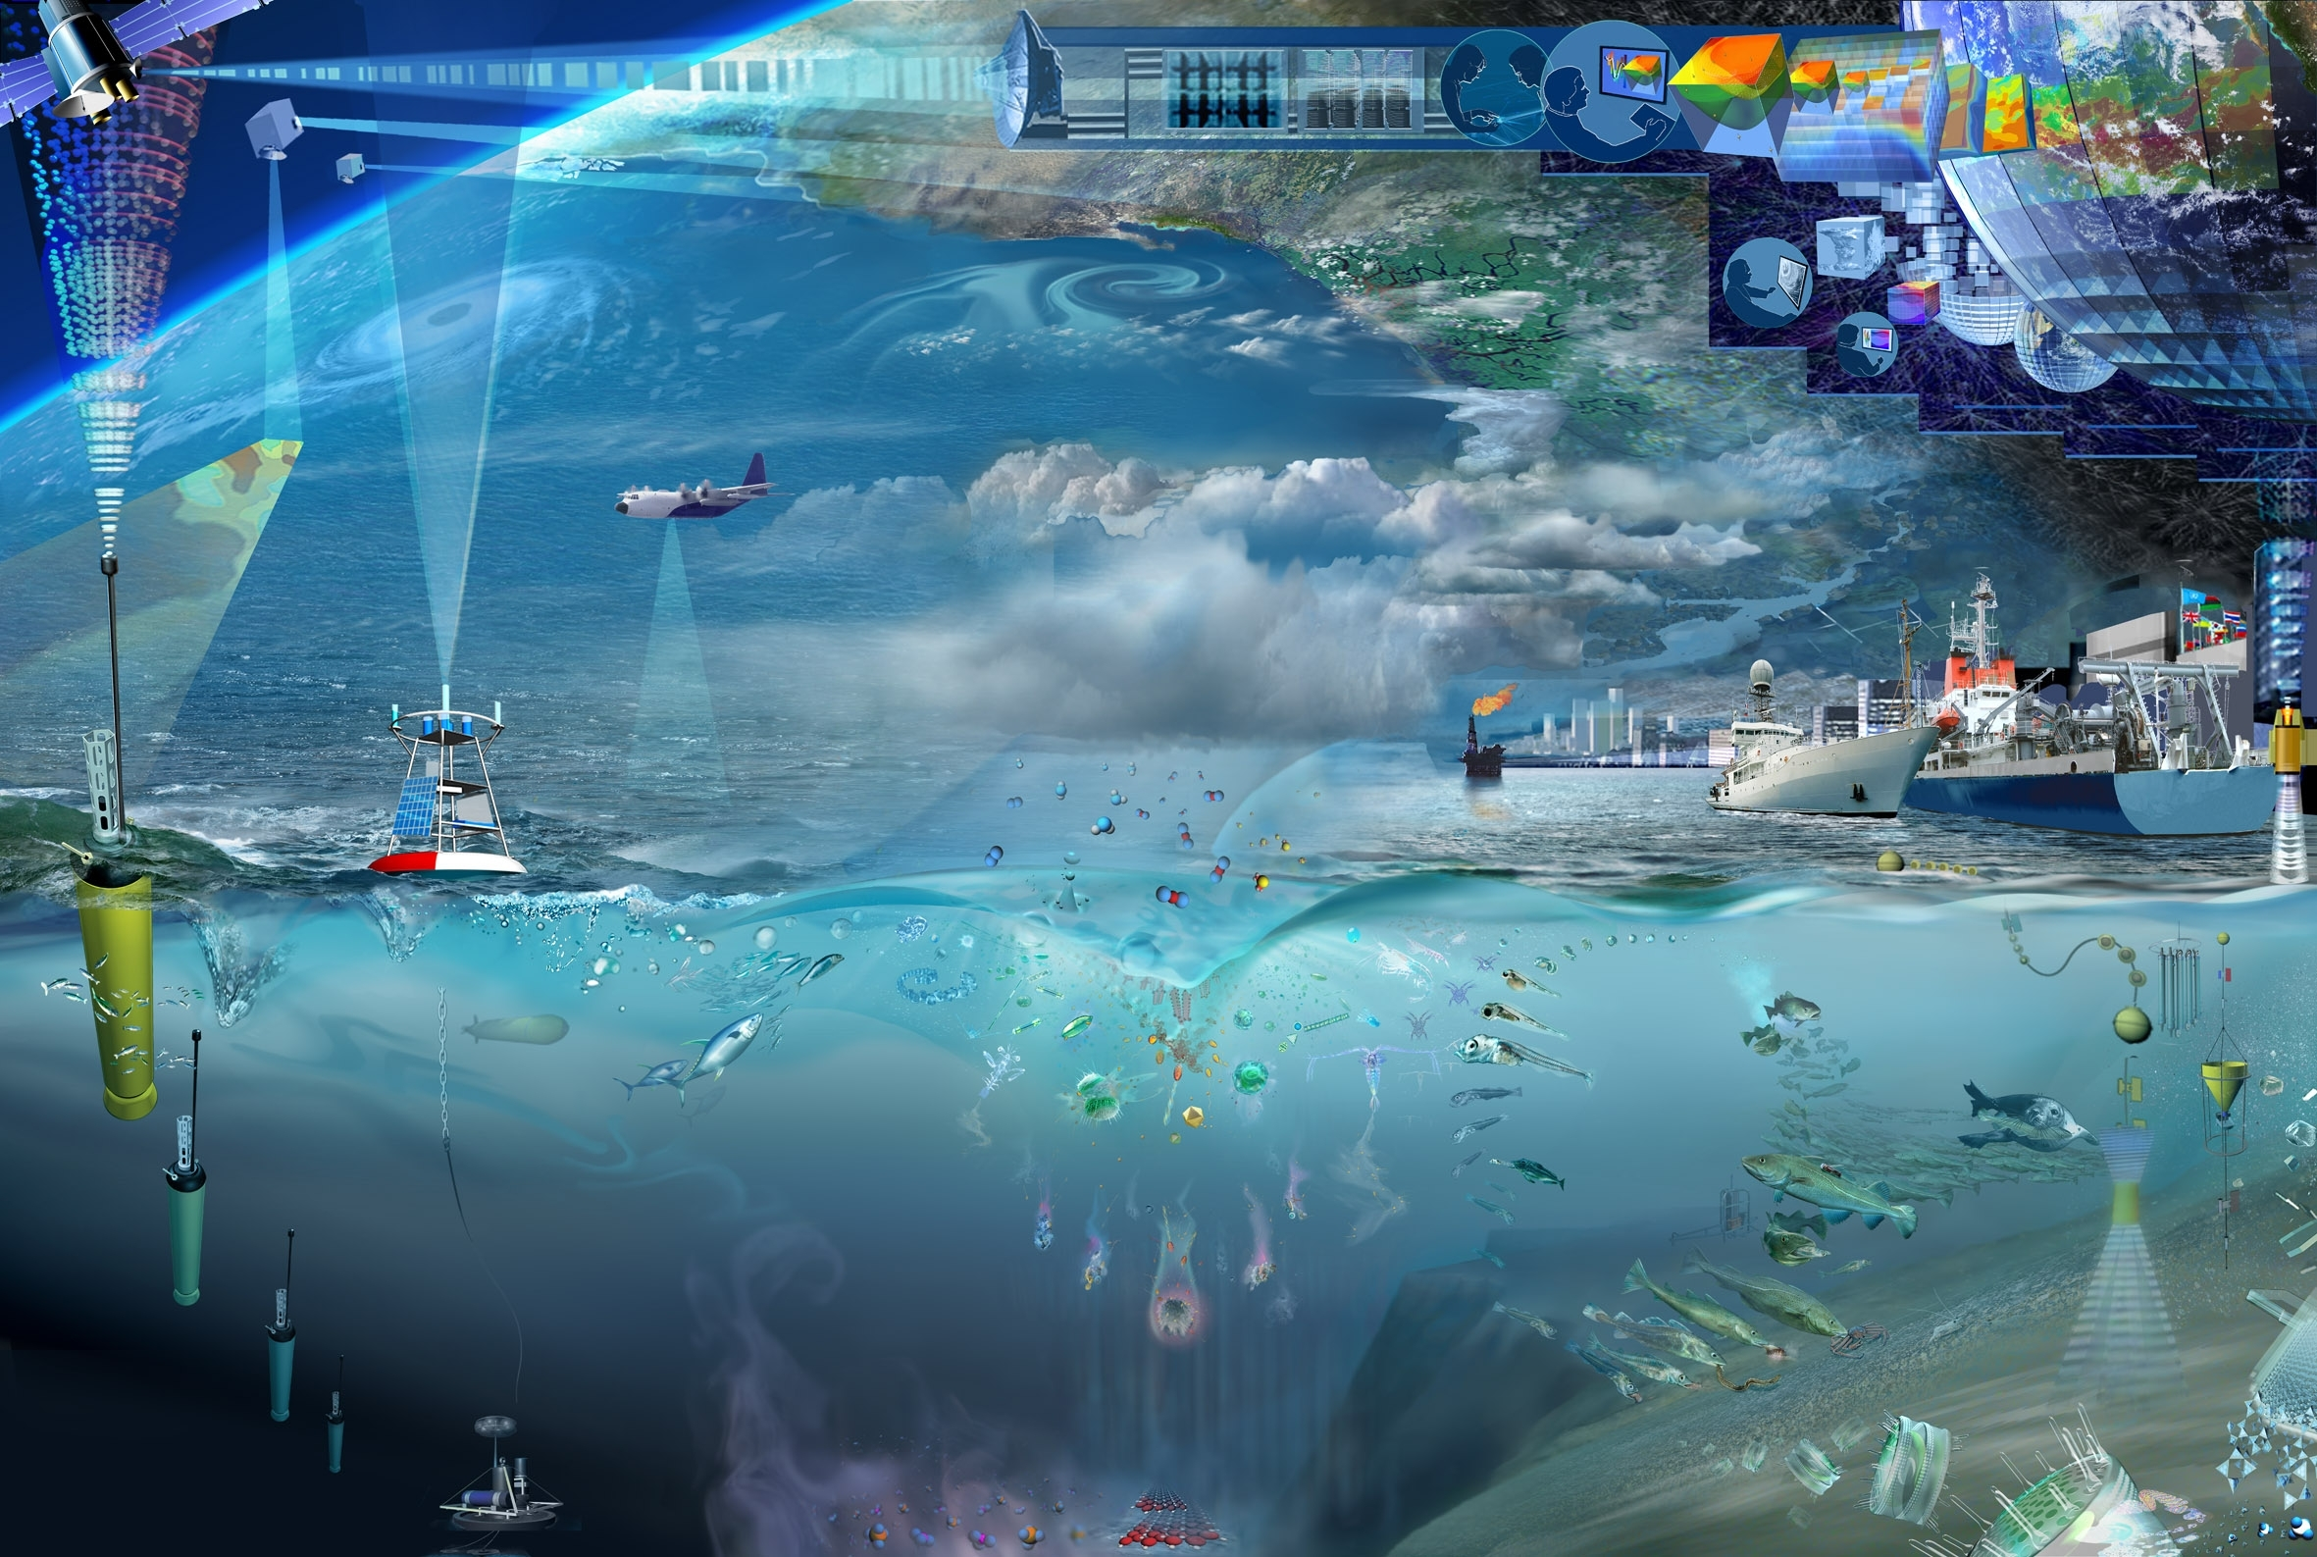
HMS Challenger / 1870s / 3.5 years / 263 profiles
WOCE / 1990s / 7 years / 10,000 profiles
Argo / 1 month / 13,000 profiles
… 2030 … ?

Slide 14
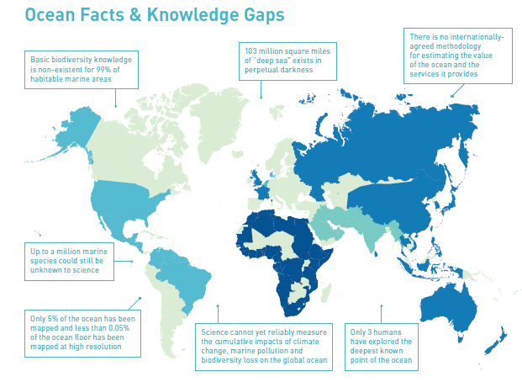
Proposal for an International Decade of Ocean Science for Sustainable Development (2021-2030)
Observing technologies
Modelling tools
Mapping of the ocean
Transdisciplinary & integrating MSR
CD & TMT
Communication & awareness

Slide 15
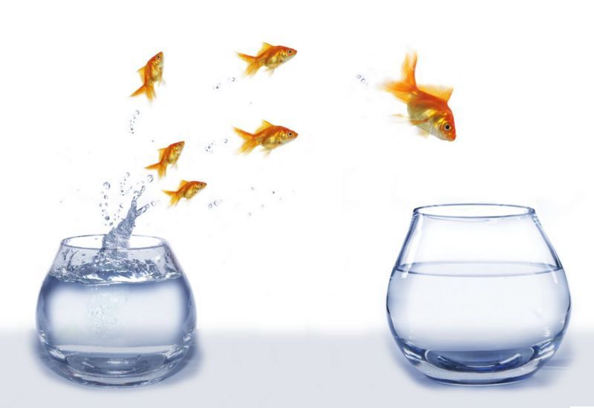
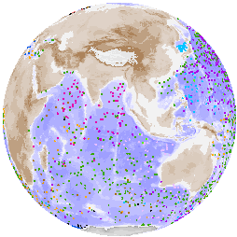
2030 +

